Slide 1
LSTM-BASED APPROACH FOR GENERATOR STATE PREDICTION IN TRANSIENT STABILITY ASSESSMENT AND CONTROL USING TRANSIENT ENERGY FUNCTION
Presented By:
Bhupesh Jaishi (078BEL026)
Binod Kumar Sah (078BEL030)
Bishal Chaurasiya (078BEL031)
Chandan Sah (078BEL032)
Supervisor : Associate Professor Jitendra Chaudhary
DEPARTMENT OF ELECTRICAL ENGINEERING
IOE, PULCHOWK CAMPUS

Slide 2
Introduction
Power System stability refers to the system's ability to return to normal or stable operation after having been subjected to some form of disturbance.
Transient stability involves the response to large disturbances, which may cause large change in rotor angle and speed leading to cascading failure of the system.
Transient stability assessment methodologies are broadly classified into three main types:
Simulation Methods (Time-Domain Simulation)
Direct Methods (Energy Function based)
Data-Driven Methods (Machine Learning based)

Slide 3
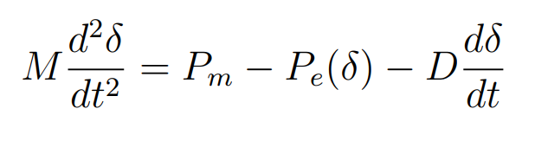
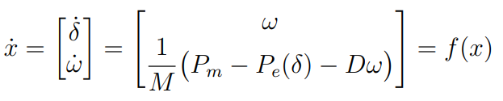
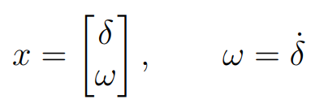
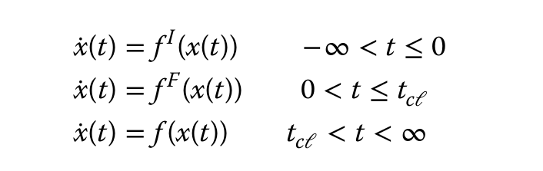
Swing Equation and State-State Formulation
Swing Equation:
State-Space Representation:
Sate Variables:
Hence Power system dynamics is described by the state space as:

Slide 4


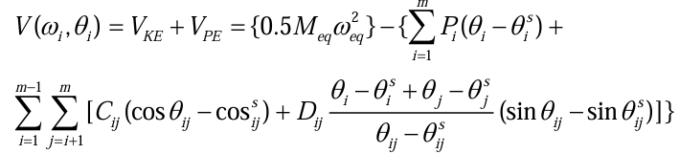
Lyapunov Function
A Scalar function which describes the total energy of the system.
Stability Criteria: 1. V(x)>0, for all x not equal to xs
2.
Transient Energy function Described for post fault system, given By

Slide 5
Literature Review
Our project is founded on the real-time prediction and control framework proposed by Bhui and Senroy [1].
They have used Transient Energy function Frame work to make assessment of transient Stability.
By Dividing the computation into two mode of computation
a.Offline Computation
b.Online Computation

Slide 6
Literature Review
In the online stage of the paper correct MOD is identified and energy margin (Vcr-Vcl) is calculated to find the stability of the system.
Control action is taken if system is found unstable by shading the appropriate generation from the system. There is need of prediction of generator angle and speed at the time of generation shedding accounting for computational delay.
The minimum amount of data available for this prediction corresponds to the computational delay associated with the application of the TEF technique , signal latency and initiating control actions delay.
Quadratic and cubic curve fitting have been used for predicting the angle which is produces error and fast simulation technique have been advised to overcome this error[1]

Slide 7
Problem Statements
Error in the prediction of rotor angle and speed:
Inaccurate prediction of rotor angle and speed lead to inaccurate generation shedding.
System May remain unstable due to prediction error.

Slide 8
Objectives
• To develop and implement an LSTM (Long Short-Term Memory) neural network model for accurate, real-time prediction of generator angles and speeds in the IEEE 39 bus system following a fault
• To integrate the generator state predictions into the Transient Energy Function (TEF) framework for improved transient stability assessment and control.
• To demonstrate the applicability of the enhanced TEF method on the IEEE 39-bus test system

Slide 9
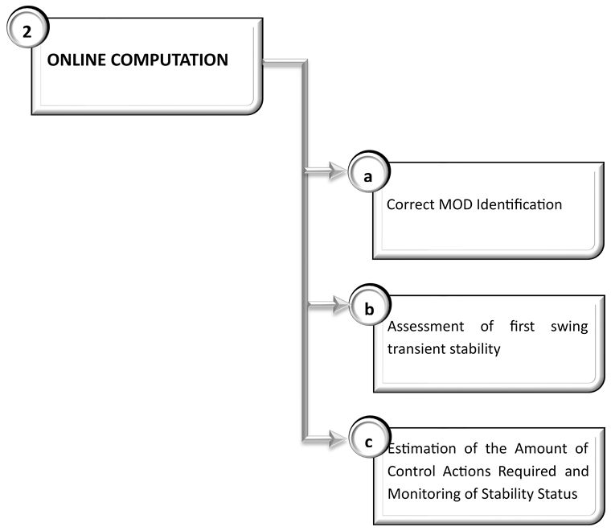
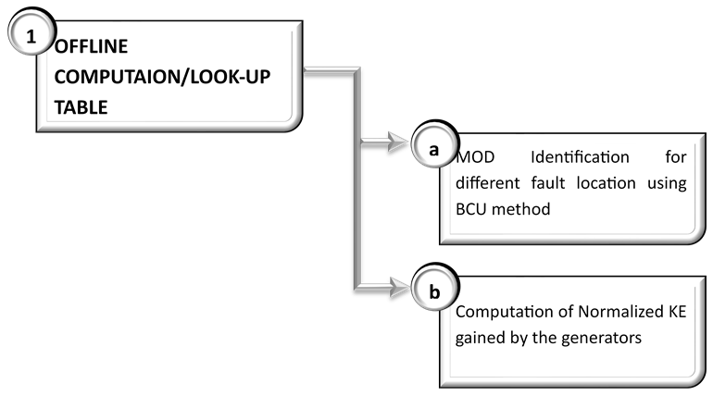
METHODOLOGY

Slide 10
1. Offline Computation/Look-up Table
a. MOD Identification for different fault location
MOD is obtained using BCU Method.
1.Tcr is calculated using BCU method
2.Time domain simulation is done for a fault duration slightly higher than Tcr.
3.Detection of peak of the potential energy and generator ranking descending order of the angles.
4.Taking top machines as MOD and calculate CCT using MOD technique.
5. machine groups with minimum error between time domain simulating CCT and TEF CCT taken as the MOD.

Slide 11
2. Online Computation
Correct Mode Identification
Step 1 : Calculation of KE
Step 2 : Ranking of Probable MODs
Step 3 : Calculation of Post-Fault SEP
Step 4 : Calculation of CUEP
Step 5 : Identification of correct MOD
b. Assessment of first swing transient stability
∆V_{cl =} V_{cr –} V_{cl >0, Stable}
_{<0, Ustable}

Slide 12
Estimation of Amount of Control Actions Required and Monitoring of Stability Status
Step 1 : Prediction of generator speed and angles[LSTM]
Step 2 : Modification in Energy Function for Generation Shedding
Step 3 : Estimation of the amount of Control action required

Slide 13
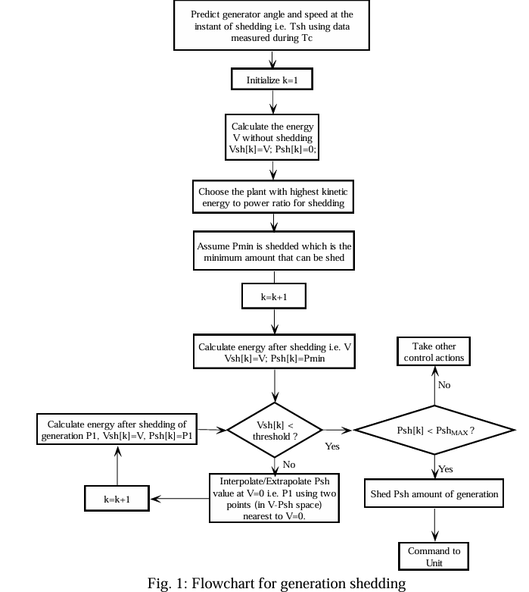

Slide 14

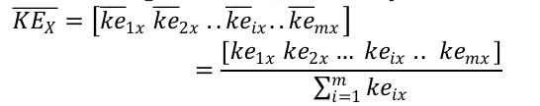
b. Computation of normalized KE gained by the generators:

Slide 15
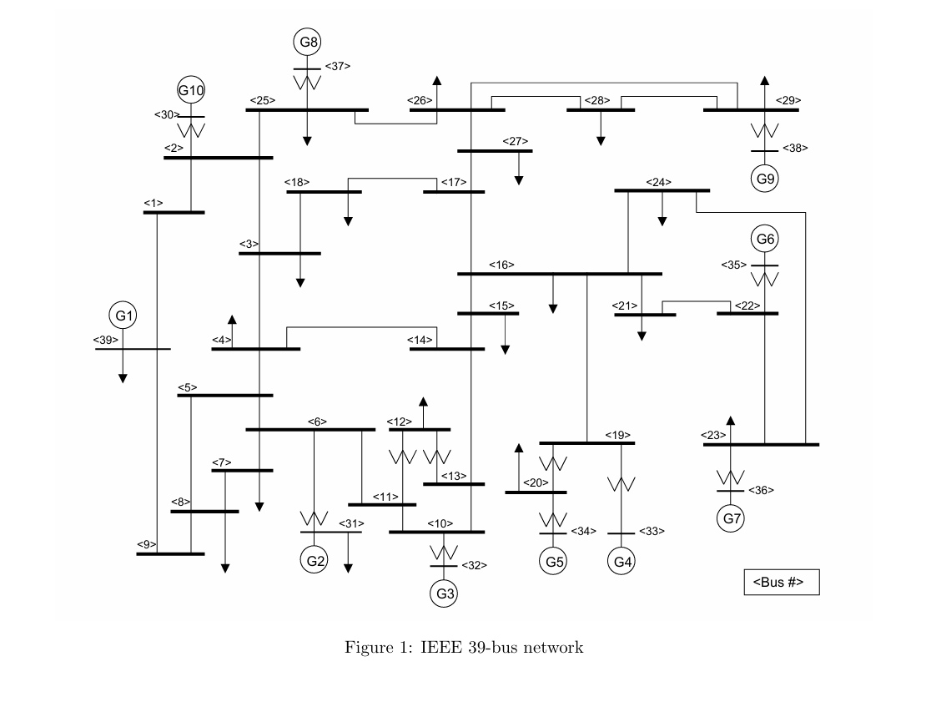
System Under Consideration

Slide 16
Tools and Software:
Scope: Network Modeling:
For the development of the TEF Internal node model is developed using the constant impedance load and internal node behind the transient reactance is used followed by Kron’s reduction to show the coupling between the generators. For the development of the real system all the parameters are included. Generator Modeling: Classical Model for TEF and Detailed Model in real time simulation in psse
Disturbance Type: 3-Phase Symmetrical Fault
Matlab
Python
PSS/E

Slide 17
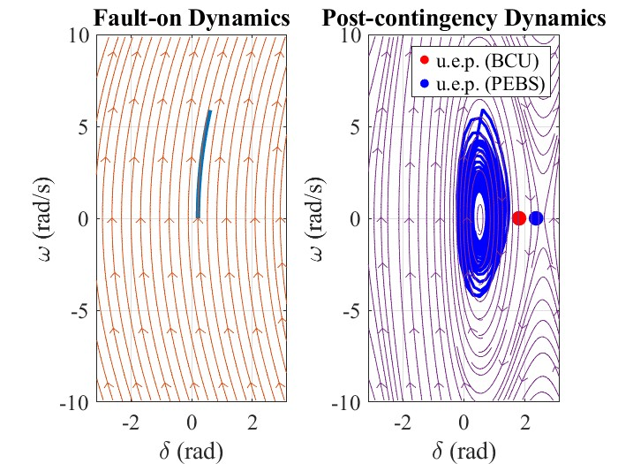
Result And Analysis
Transient Energy Function and BCU Results From MATLAB
Transient energy function framework is developed for IEEE-9 bus system using classical model consideration. Fault at different location is created and results obtained is shown in the table below:
Result 1
Fault At bus 7 at t=0 and cleared at 0.15
Result | TDS | BCU | PEBS
V | Vcl =0.843 | Vcr_BCU=0.973 | Vcr_PEBS=1.25
Critical clearing time (Tcl) | Tcl=0.15 | Tcr_BCU=0.162 | Tcr_PEBS=0.184
Computation Time | 0.23 | 0.2 | 0.17
Vcr_PEBS> Vcl
Tcr_PEBS>Tcl System is PEBS Stable
Vcr_BCU> Vcl
Tcr_BCU>Tcl System is BCU Stable
Fig 8: w vs del for faulted and Post fault Dynamics (Stable)

Slide 18
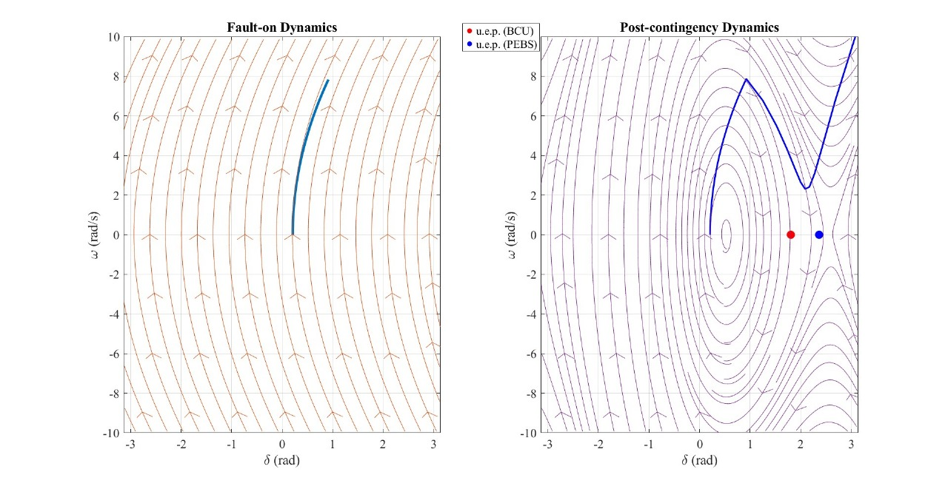
Result And Analysis
Result 2
Fault At bus 7 at t=0 and cleared at 0.2
Result | TDS () | BCU | PEBS
V critical | Vcl=1.473 | Vcr_BCU=0.973 | Vcr_PEBS=1.25
Critical clearing time (Tcl) | Tcl=0.2 | Tcr_BCU=0.162 | Tcr_PEBS=0.184
Computation Time | 0.15 | 0.1 | 0.07
Vcr_PEBS> Vcl
Tcr_PEBS>Tcl System is PEBS Unstable
Vcr_BCU> Vcl
Tcr_BCU>Tcl System is BCU Unstable
Fig 10: w vs del for faulted and Post fault Dynamics (Unstable)

Slide 19
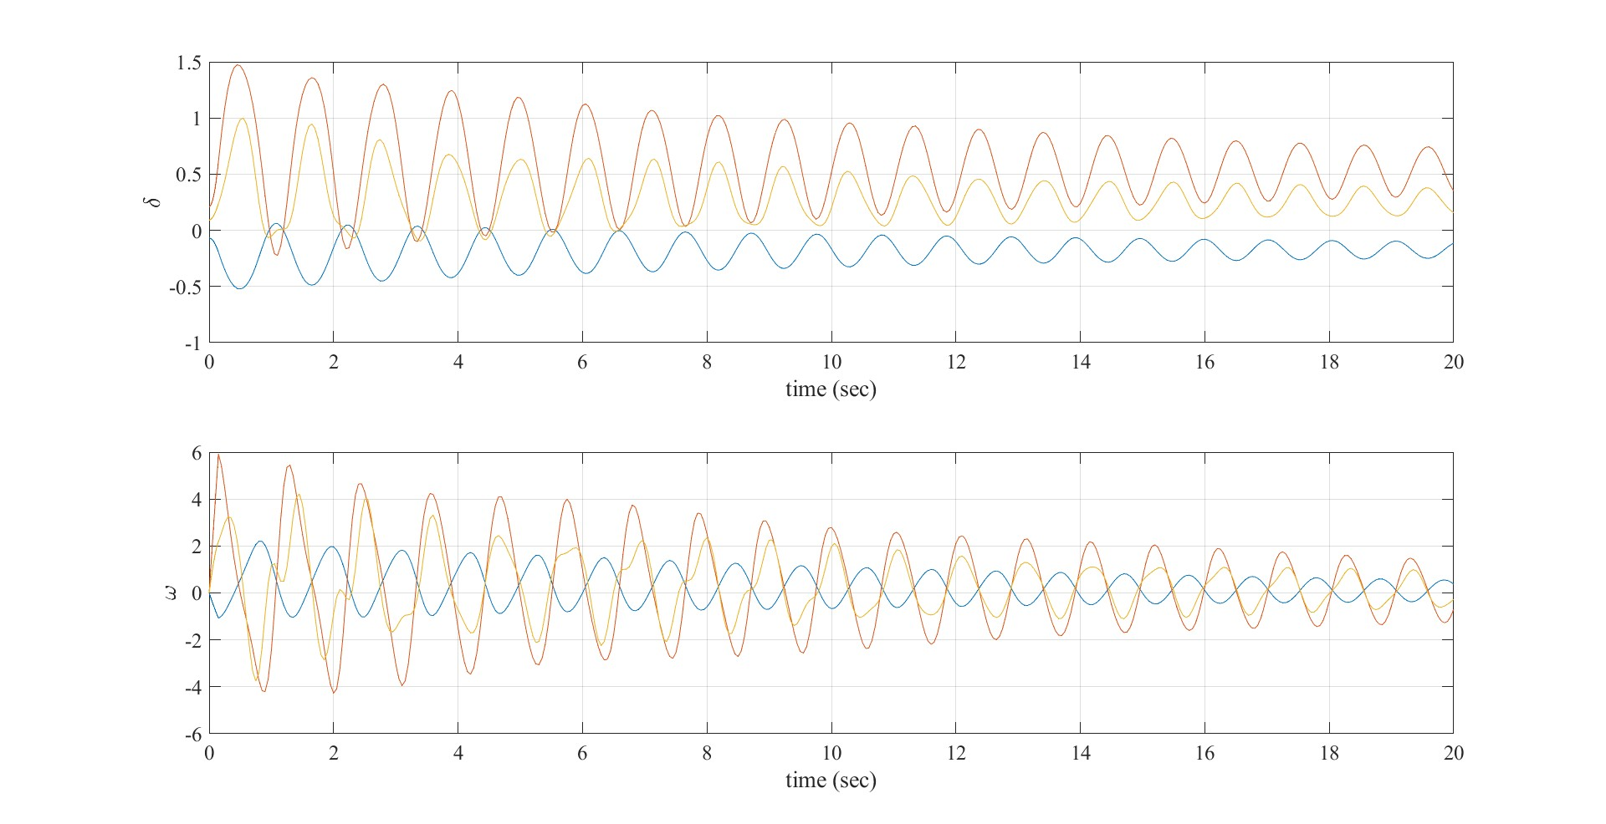
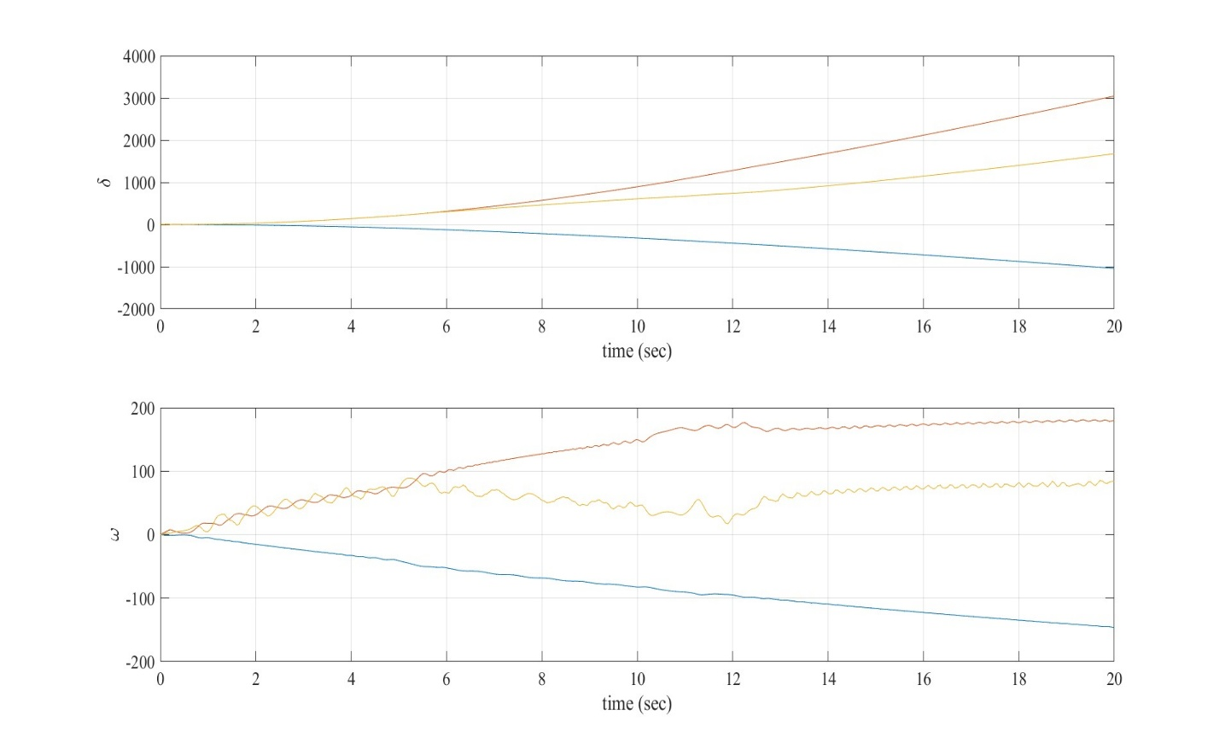
Result And Analysis
Fig 9: del vs t and w vs t for faulted and
Post fault Dynamics (Stable)
Fig 11: del vs t and w vs t for faulted and
Post fault Dynamics (Unstable)

Slide 20
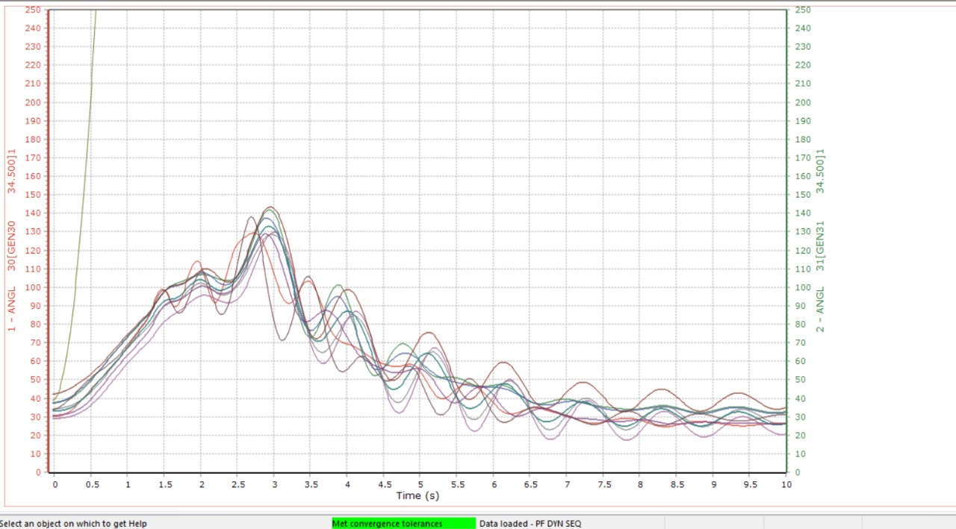
Result And Analysis
Time Domain Simulation Using PSS/E:-
Output 1:
Fault created at Bus 29 at t=1.0 and cleared at t=1.4.
Generator G9 goes out of synchronism.
Plot 1[time vs rotor angle]

Slide 21
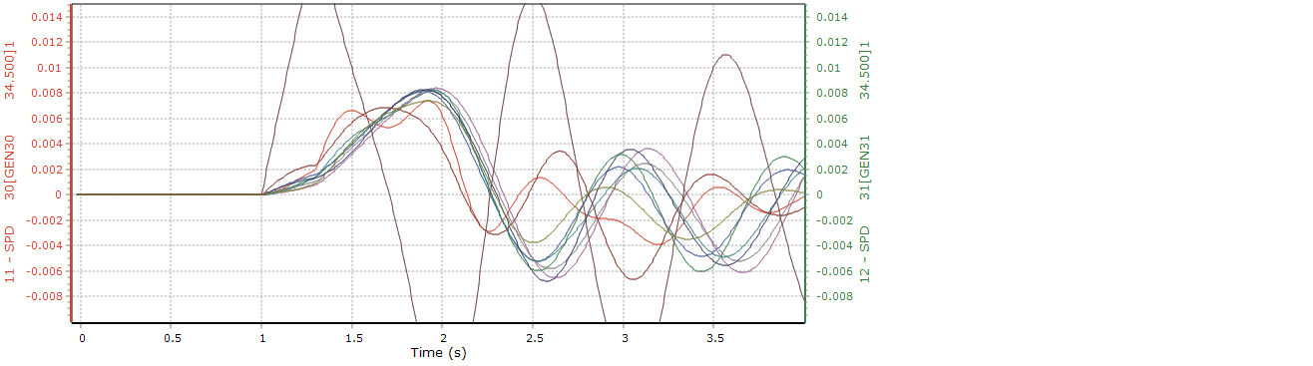
Output 2:
Fault created at Bus 29 at t=1.0 and cleared at t=1.3.
Generator G9 goes out of synchronism.
Plot 2 [time vs speed]

Slide 22
Output 3:
Fault created at Bus 29 at t=1.0 sec and cleared at t=1.3
Fig 14: plot 3 [time vs speed]

Slide 23
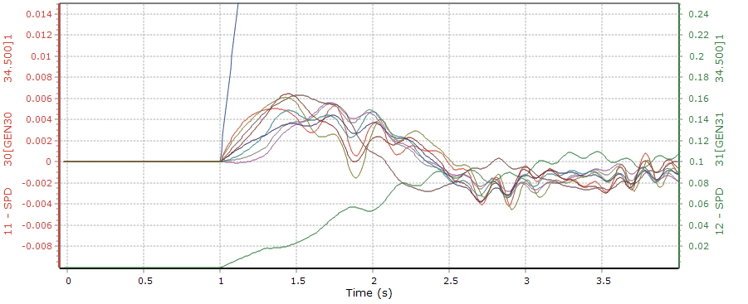
Output 4:
Fault created at bus 10 at t=1.0 sec and cleared at t=1.3 sec.
Fig 15: Plot 4[time vs speed]

Slide 24
REMAINING WORK
Lookup Table
LSTM
Model Training
Integration of LSTM with TEF for control action
Testing & Validation:
Documentation

Slide 25
Conclusion
TEF Framework for IEEE-9 Bus is developed and Stability is analyzed in the result section.
IEEE39 bus system is completely developed in PSSE
Result for the different fault location has been analyzed at current stage in IEEE 39 Bus system using PSSE along with Training Data Collection

Slide 26
References
[1] P. Bhui and N. Senroy, "Real Time Prediction and Control of Transient Stability Using Transient Energy Function," IEEE Trans. Power Syst., doi: 10.1109/TPWRS.2016.2564444.
[2] F. Silva-Rodriguez, H. Raffoul, and Y. Li, “LSTM-Based Net Load Forecasting for Wind and Solar Power-Equipped Microgrids,” in Proceedings of the 2024 IEEE Power & Energy Society General Meeting (PESGM), Seattle, WA, USA, Jul. 2024, pp. 1–6. doi: 10.1109/PESGM56776.2024.1234567.
[3] G. Van Houdt, C. Mosquera, G. Nápoles, “A review on the long short term memory model,” Artificial Intelligence Review, vol. 53, pp. 5929 5955, 2020.
[4] H. D. Chiang, F. Wu and P. Varaiya, “A BCU method for direct analysis of power system transient stability,” IEEE Trans. Power Syst., vol. 9, pp. 1194–1208, Aug. 1994.
[5] P. W. Sauer, M. A. Pai, and J. H. Chow, Power System Dynamics and Stability, Second Edition. Hoboken, NJ, USA: John Wiley & Sons Ltd, 2018.

Slide 27
Thank You!

